Slide 1
How to work with parameters and stored procedures

Slide 2
Notes:
2
Parameters and Stored Procedures
This chapter builds on the skills you learned in the last chapter by presenting some additional techniques for working with commands Specifically, you'll learn how to work with commands that use parameters to retrieve, insert, update, and delete data. And you'll learn how to execute a stored procedure from a command.
When you complete this chapter, you'll have all the skills you need for working with commands in the three-layer applications that you develop.

Slide 3
Benefit parameters
// don't ever do this (any more)
SqlCommand cmd = new SqlCommand("select * from Customers where city = '" + inputCity + “’”);
inputCity → typically retrieved from a TextBox or other control
Anything placed into that TextBox control will be put into inputCity and added to your SQL string ➔ invites a hacker to replace that string with something malicious (= SQL Injection)
In the worst case, you could give full control of your computer away

Slide 4
How to Use Parameters in SQL Statements
Notes:
4
Parameters
When you work with commands, you have to create the parameters yourself. You'll learn how to do that in the next slides. But first, you need to know how to use parameters in the SQL statements you code.
A parameter is a variable that's used in a SQL statement. Parameters let you create statements that retrieve or update database data based on variable information.
For example, an application that maintains the Vendors table can use a parameter in the Where clause of a Select statement to retrieve a specific row from the Vendors table based on the value of the VendorlD column.
A Select statement that uses parameters in the Where clause is called a parameterized query. You can also use parameters in other types of SQL statements, including Insert, Update, and Delete statements.
To use parameters in a SQL statement, you use placeholders as shown in the slide. These placeholders indicate where the parameters should be inserted when the statement is executed.
Unfortunately, database management systems don't use a standard syntax for coding placeholders.
For example, the first Select statement in this slide is for SQL Server. As you can see, you use a named variable to identify a parameter. Note that the name of the variable must begin with an at sign (@) and is usually given the same name as the column it's associated with.
Oracle also uses named variables, but the names must begin with a colon (:) as illustrated in the second Select statement.
In contrast, the placeholder for an OLE DB or ODBC parameter is a question mark, as shown in the third Select statement.

Slide 5
Input and Output Parameters
Notes:
5
Parameters
The first example on this slide shows how you can use parameters in an Insert statement: a row is being inserted into the Vendors table.
To do that, a variable is included in the Values clause for each required column in the table.
All of the parameters in these first examples are input parameters because they provide input to the database.
In contrast, the last example uses output parameters, which receive values from the database.
The Select statement retrieves six columns from a single row of the Vendors table just as the Select statement in the first example does, but in this case the column values are stored in output parameters.
When you use output parameters, you don't have to use a data reader to get the values, which can improve the efficiency of an application. However, you'll probably want to use this technique only when you're retrieving a small number of values. Otherwise, the parameters can get unwieldy.

Slide 6
Create a Parameter: SqlParameter Class
Notes:
Parameters
After you define a SQL statement that contains parameters, you create the parameter objects.
This slide shows you how to do that. You can see four constructors for the SqlParameter class. Although there are others, these are the ones you're most likely to use.
You can create a parameter for an OLE DB, ODBC, or Oracle command using similar techniques.
Before you can use a parameter, you must assign a name to it.
In addition, if the parameter will be used for input, you must also assign a value to it.
If the parameter will be used for output and it will hold string data, you must assign a size to it.

Slide 7
SqlParameter Properties
Notes:
7
Parameters
If you don't pass these values as arguments to the constructor when you create the parameter, you can do that using some of the properties shown on this slide.
Note here that you can specify the data type using either the DbType or SqlDbType property for a SQL Server parameter.
Because the data type is inferred from the value of the parameter, you usually won't set the type for an input parameter. However, you may want to specify the type for an output parameter.

Slide 8
Create Input and Output Parameters
Notes:
Input Parameters
The first example on this slide shows how to create a parameter object using the first constructor for the SqlParameter class. This parameter is assigned to a variable named vendorlDParm. Then, this variable is used to set the parameter's properties.
The second example shows how to create a parameter using a single statement. This statement uses the second constructor for the SqlParameter class to create a parameter named @VendorID with the value specified by the vendorlD variable.
In contrast to the first two examples, the third example creates an output parameter. It uses the fourth constructor to specify the name, type, and size for the parameter. Then, it sets the Direction property of the parameter to ParameterDirection.Output.
When you assign a name to a SQL Server or Oracle parameter, that name must be the same as the name that's specified in the SQL statement. That's because ADO.NET associates the parameters with the placeholders by name.
As a result, if a statement uses two or more parameters, you can add them to the Parameters collection in any sequence.
In contrast, OLE DB and ODBC parameters must be added to the collection in the same order that they appear in the SQL statement.
In that case, ADO.NET associates the parameters with the placeholders by sequence since the placeholders aren't named.

Slide 9
Common members of the Parameters collection of the Command Class
Indexer | Gets the parameter…
[parametername] | With the specified name
[index] | At the specified position
Method | Adds…
Add(parameter) | The specified parameter to the collection.
Add(name, type) | A parameter with the specified name and type to the collection
Add(name, type, size) | A parameter with the specified name, type, and size to the collection.
AddWithValue(name, value) | A parameter with the specified name and value to the collection
Notes:
Parameters
After you create a parameter, you must add it to the Parameters collection of the command that will use the parameter.
On the slide you can find the members of the Parameters Collection.
The Parameters property of the command is used to refer to the Parameters collection.
On the next slide we’ll see some examples to add input and output parameters to this collection.

Slide 10
Notes:
Parameters
The Add method of the collection is used to add the vendorlDParm parameter that was created on slide 8.
You can also use one of the overloaded Add methods to create a parameter and add it to the Parameters collection in a single statement. These methods let you specify a name and type or a name, type, and size, and they return the parameter that's created. That way, you can store the parameter in a variable so you can refer to it later if you need to.
Another way to create a parameter and add it to the Parameters collection is to use the AddWithValue method. This is illustrated in the second example on this slide, and this is the easiest way to create an input parameter.
Like the Add methods, the AddWithValue method returns the parameter that's created in case you want to refer to it later: SqlParameter param = selectCommand.Parameters.AddWithValue(“@VendorID”, vendorID);
If you don't create a variable to hold a parameter, you can refer to it through the Parameters collection as illustrated in the third example. Here, the value of the @VendorID parameter is set to the value of a variable named vendorlD.

Slide 11
Notes:
Output Parameters
The example on this slide shows how to work with a command that uses output parameters.
Although it's not shown here, this command contains the last Select statement shown on slide 5.
The first thing you should notice is that the ExecuteNonQuery method is used to execute this command, even though it contains a Select statement. That's because you don't need a data reader to get the results of the query.
Instead, the results will be stored in the output parameters.
After you execute a command that contains output parameters, you can refer to the parameters using the same techniques you use to refer to input parameters.
In this example, parameter variables are used to display the parameter values in text boxes.
Notice that the values of the parameters are converted to strings. That's necessary because the Value property is an Object type.

Slide 12
Demo:
A Vendor Maintenance application that uses parameters
(Source Code: wpfVendorMaintenanceDemo : BlackBoard)

Slide 13
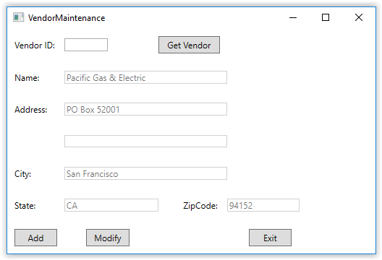
The vendor maintenance form
Notes:
13

Slide 14
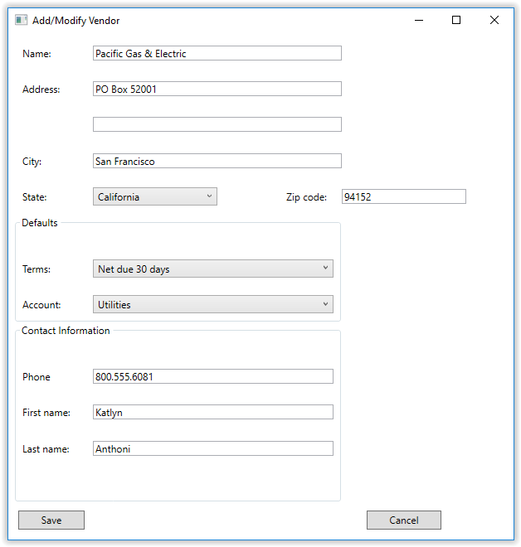
Notes:
14

Slide 15
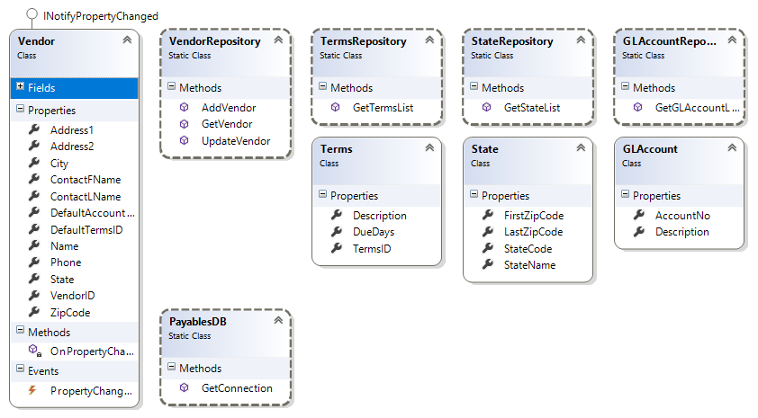
Notes:
15

Slide 16
Notes:
Stored Procedures
Instead of using Select, Insert, Update, and Delete statements that are coded in your application, you can use stored procedures that contain the statements you need.
A stored procedure is a database object that contains one or more SQL statements.
In the topics that follow, you'll learn how to work with stored procedures. But keep in mind as you read these topics that they're not meant to teach you how to code stored procedures. They're just meant to give you an idea of how stored procedures work and how you can use them from C# applications.
When you send a SQL statement to a database management system for processing, the DBMS must compile and optimize the query before it executes it.
In contrast, because a stored procedure is stored with the database, it only has to be compiled and optimized the first time it's executed. Because of that, stored procedures can improve the efficiency of a database application.
The slide illustrates how a stored procedure works. You can see a Create Procedure statement that creates a stored procedure named spGetVendorAddress.
This stored procedure contains a Select statement that retrieves data for a vendor from the Vendors table based on the Vendor ID.
Notice that this stored procedure requires a parameter, which is defined at the beginning of the procedure.

Slide 17
Notes:
Stored Procedures
To execute a stored procedure, you use a command object as on the slide.
The CommandText property is set to the name of the stored procedure, and the CommandType property is set to CommandType.StoredProcedure.
In addition, a parameter that will contain the value that's passed to the stored procedure is added to the Parameters collection of the command.
The connection is opened and the command is executed.
Because the stored procedure in this example contains a Select statement, the ExecuteReader method is used to execute the command and store the result set in a data reader.
You can use the ExecuteNonQuery method to execute a stored procedure that contains an Insert, Update, or Delete statement, and you can use the ExecuteScalar method to execute a stored procedure that returns a single value.
When you use a stored procedure in a three-layer application, you execute it from a database class. In the Vendor Maintenance application, for example, the command in the GetVendor method in the VendorRepository class could be replaced with a command that uses a stored procedure. In other words, when you call a method like this in a database class, it will work equally well whether it uses a query or a stored procedure. And you can change a method in a database class so it uses a stored procedure without changing anything else in the application.

Slide 18
Notes:
Stored Procedures
The stored procedure you saw in the last slide used just an input parameter. But stored procedures can also use output parameters, and they can return a return value. The slide illustrates how this works.
At the top of this slide, you can see a stored procedure that inserts a new row into the Vendors table.
This procedure uses input parameters for each of the required columns in this table.
In addition, it uses an output parameter that will return the identity value that's generated for the Vendor ID column.
To assign a value to this parameter, the procedure uses a Set statement. As you can see, this statement assigns the value of the SCOPE_IDENTITY function to this parameter. SCOPE_IDENTITY is a SQL Server system function that returns the last value that was generated for an identity column within the current scope. In this case, the scope is the stored procedure.
This procedure also includes a Return statement that passes a return value back to the program. In this case, the procedure simply returns the value of the @@ERROR system function, which will contain the error number that was generated by the Insert statement. If no error was generated, this function will return a value of zero.

Slide 20
Notes:
Stored Procedures
The C# code shown on the slide illustrates how you can use the output parameter and return value included in this stored procedure.
To do that, you add parameter objects to the Parameters collection of the command that will execute the stored procedure.
To indicate that a parameter will receive a return value or output from the stored procedure, you set its Direction property as shown here.
After the query is executed, you can get the values of the parameters through the Parameters collection.
In this example, the @Error parameter is checked to see if it has a value of zero, which indicates that no error occurred.
Then, the value of the @VendorID parameter is assigned to the VendorlD property of a Vendor object. Otherwise, some other processing is performed.
If you understand how to use commands to execute queries, you shouldn't have any trouble using them with stored procedures. Before you use an existing stored procedure, though, you'll need to find out how it's defined, what parameters it uses, and whether it includes a Return statement. That way, you can define your command objects accordingly.

